Slide 1

We care for your knowledge
Electrosoft
S y s t e m

Slide 2
Contents
Block diagram explanation
Pin configuration
Circuit diagram explanation

Slide 3
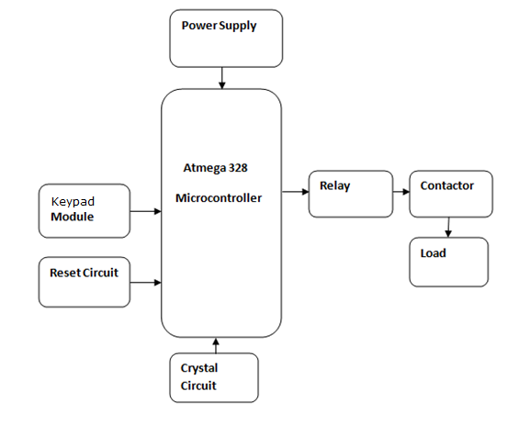
Block diagram

Slide 4

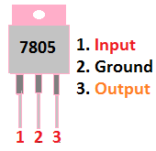
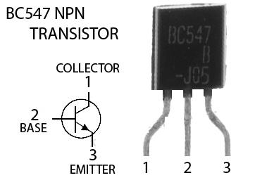
Pin configuration

Slide 5
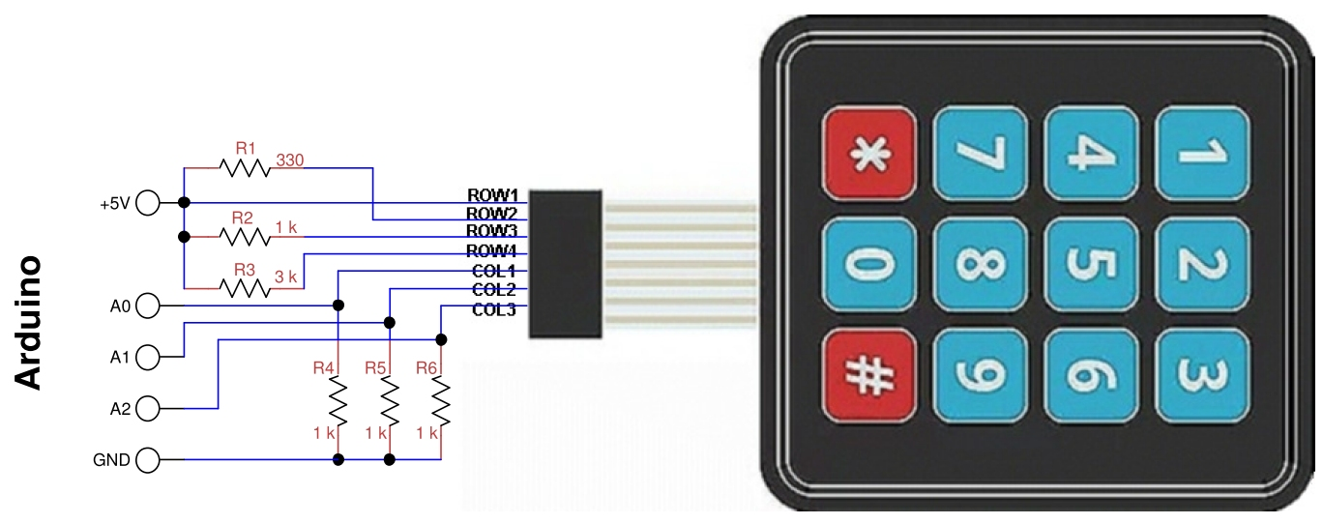
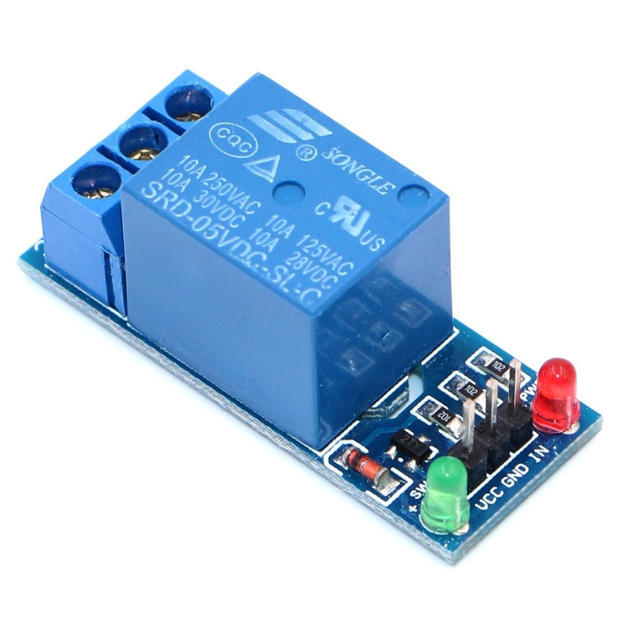
Relay module
Kaypad 4X3 module

Slide 6
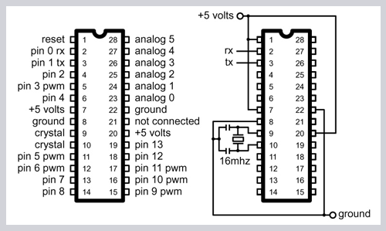

Slide 7
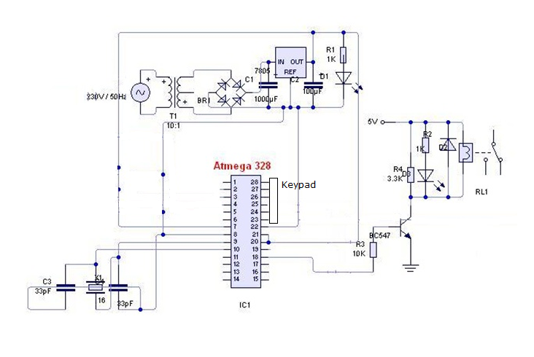
Circuit Diagram

